Slide 1
Workshop XX Transonic Flow over a RAE 2822 Airfoil
Introductory FLUENT Training

Slide 2
Goals
The purpose of this tutorial is to introduce the user to good techniques for modelling flow in high speed external aerodynamic applications
Transonic flow will be modelled over a RAE 2822 airfoil for which experimental data has been published, so that a comparison can be made
The flow to be considered is compressible and turbulent
The used solver is the density based implicit solver
The tutorial is carried out using FLUENT and CFD Post from within Workbench, but it could also be completed in standalone mode

Slide 3
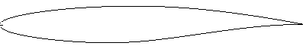
Task Description
Simulation Goals
Drag and Lift Coefficient
Flow Field
Ma number
Pressure
C_{L}?
α
Ma = 0.75
p_{static} = 11111 Pa
T_{static} = 216.65 K
α = 3,19°
C_{D}?

Slide 4

Start FLUENT Stand-alone
Start a Stand-alone FLUENT session:
Start/All Programs/ANSYS12.0/Fluid Dynamics/Fluent
Or use the Short Cut (Windows)

Slide 5
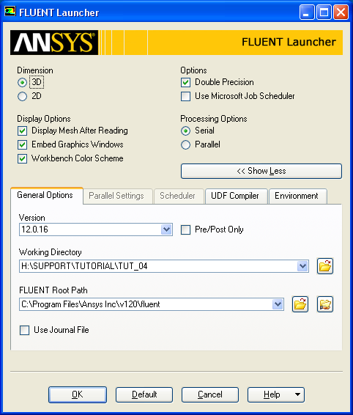
Start FLUENT Stand-alone
Start a Stand-alone FLUENT session:
Launch a 3D, double precision, serial session

Slide 6
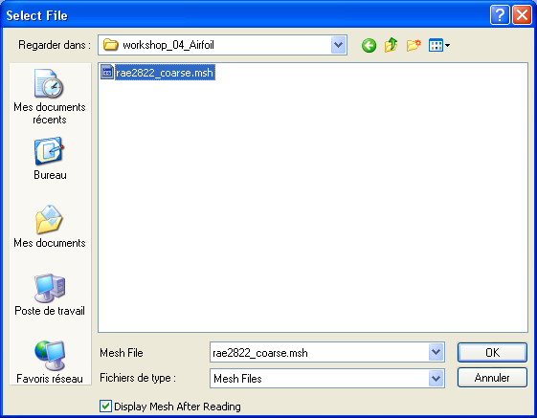
Import the mesh
Import the mesh file
File/Read/Mesh/
Select the mesh file rae2822_coarse.msh

Slide 7
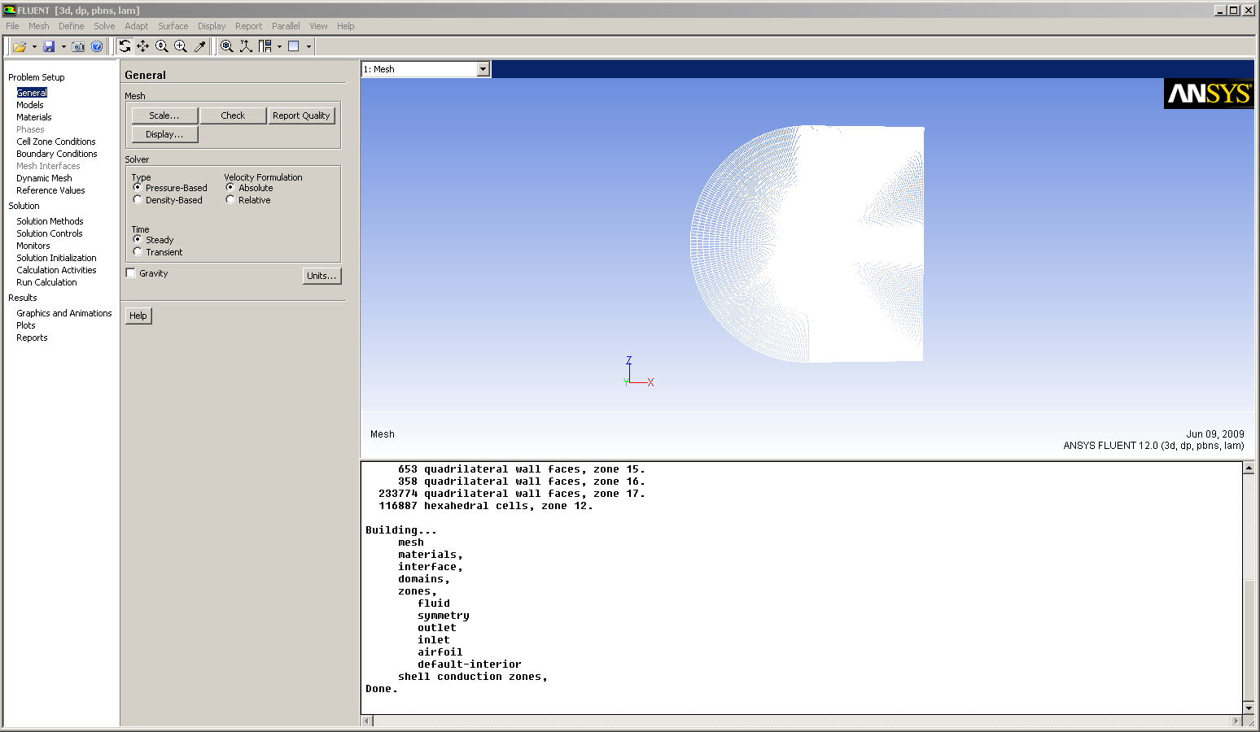
Mesh
The mesh will read in and display
Rotate the mesh so you can see the mesh like shown below

Slide 8
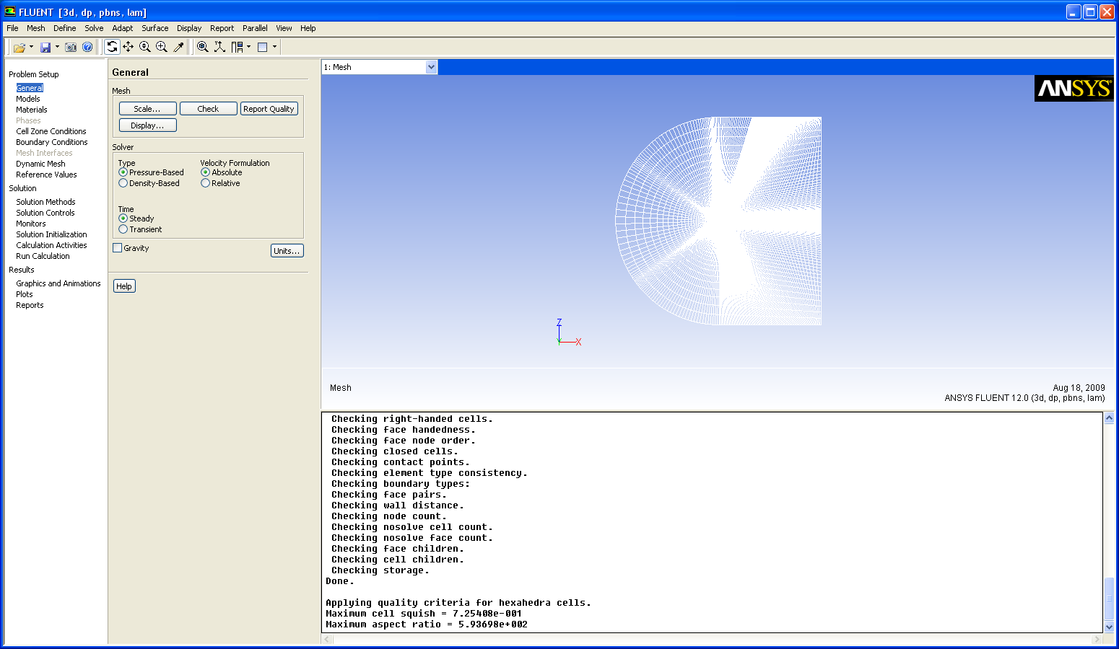
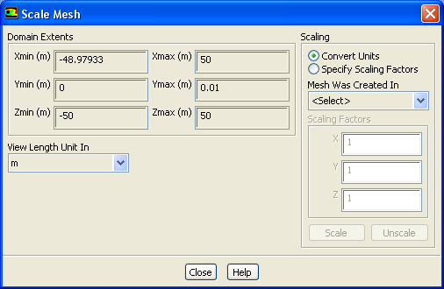
Mesh (2)
Select General > Scale and observe the current domain extents
Check that the domain extents are as expected.
Select General > Check and check there are no errors
Finally use ‘Report Quality’ to print out cell quality statistics

Slide 9
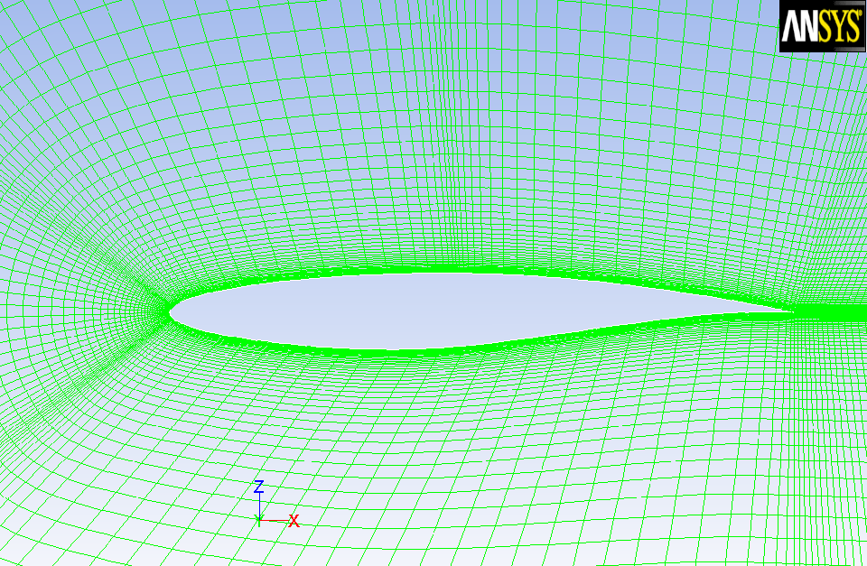
Mesh (3)
Zoom in and examine the mesh
The maximum aspect ratio in this mesh is quite high (around 7000)
This is acceptable because these cells are close to the airfoil wall surfaces
This is needed for the turbulence model being used, since it ensures the first grid point is in the viscous sublayer

Slide 10
Solver
Select the steady-state implicit density-based solver
From ‘General’ in the tree check Type: Density-Based
Check time is steady
Turn on the energy equation
This is needed because the flow is compressible and we will be using the ideal gas equation
Select the turbulence model to be used
From ‘Models’ in the tree, select ‘Viscous’ and Edit
Choose the two-equation SST-k-omega model

Slide 11
Materials
The properties to be used for the material ‘air’ need to be set
For Density, select ‘Ideal Gas’
For Viscosity, select “Sutherland”, and accept the default settings for the 3 Coefficient method
The Sutherland law for viscosity is well suited for high-speed compressible flow. For simplicity, we will leave Cp and Thermal Conductivity as constants. Ideally, in high speed compressible flow modeling, these should be temperature dependent as well
Select Change/Create
Assign the material ‘air’ to the grid cells
Select ‘Cell Zone Conditions’
Highlight ‘fluid’ then ‘Edit’
Observe ‘air’ is already selected

Slide 12
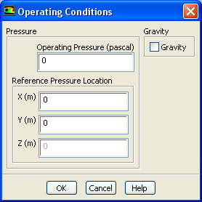
Operating Conditions
Set the Operating Pressure to Zero
Absolute pressure is the gauge pressure plus the operating pressure
Setting zero operating pressure means that all pressures set in FLUENT will be absolute
This is the most common practice for compressible flows
Select ‘Cell Zone Conditions > Operating Conditions
Set the Operating Pressure to Zero, then ‘OK’

Slide 13
Boundary Conditions - inlet
Select ‘Boundary Conditions’
Set inlet to type pressure-far-field
Pressure far-field conditions are used in ANSYS FLUENT to model a free-stream condition at infinity, with free-stream Mach number and static conditions being specified
It is a non-reflecting Boundary Condition
Use
The pressure-far-field boundary type is applicable only when the density is calculated using the ideal-gas law
It is important to place the far-field boundary far enough from the object of interest. For example, in lifting airfoil calculations, it is not uncommon for the far-field boundary to be a circle with a radius of 20-50 chord lengths

Slide 14
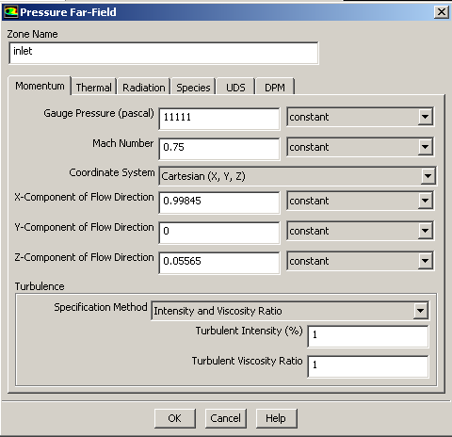
Boundary Conditions - inlet
On the ‘Momentum’ tab
set the gauge static pressure to 11111 Pa
This value is used to calculate the total pressure based on the MA number
Set the Mach Number to 0.75
The angle of attack (α) in this numerical case is 3.19 deg.
The x-component of the flow is cosα (0.99845)
The z-component of the flow is sinα (0.05565)
It is common practice to adjust the numerical α from the experimental α in order to match the lift obtained in the wind tunnel, and then to determine the drag associated with this lift. This adjustment of α is carried out to counter the effects of the wind tunnel enclosure.
Select ‘Intensity and Viscosity Ratio’
Set Turbulent Intensity to 1%
Set Turbulent Viscosity Ratio to 1

Slide 15
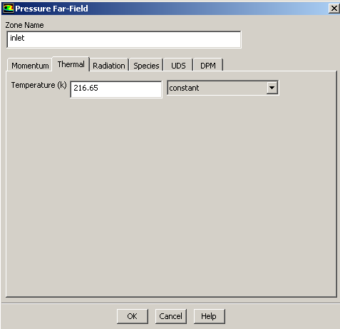
Boundary Conditions - inlet
Select the Thermal tab
Set the Static Temperature to be 216.65 K
The total Temperature is calculated based on the Ma number

Slide 16
Boundary Conditions – airfoil & symmetry
For the boundary airfoil select type wall
Leave the default settings which correspond to a no-slip condition for momentum and adiabatic (Heat flux = 0) for thermal
For the boundary symmetry select the type symmetry
No further settings possible

Slide 17
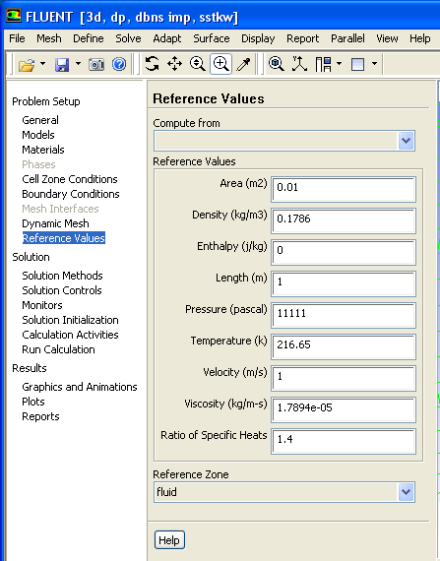
Reference Values
Set the reference values as shown:
These are not used in the actual solution, but are used for reporting coefficients, such as C_{L} and C_{D}.
Infinite BC
Area | 0.01
Density | 0.1786
Length | 1
Pressure | 11111
Velocity | 216.65

Slide 18
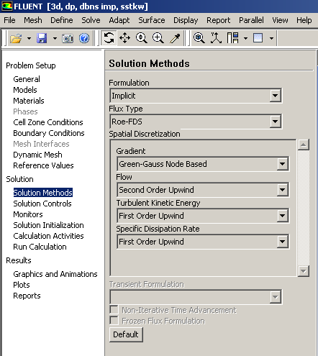
Solution Methods
Select Solution Methods in the LHS tree
Keep the default settings for the implicit formulation and Roe-FDS flux type
This will enable the Density-based Coupled Implicit Solver
The Density-based Coupled implicit formulation is more stable and can be driven much harder to reach a converged solution in less time
The Density-based Coupled explicit formulation is only normally used for cases where the characteristic time scale is of the same order as the acoustic time scale, for example the propagation of high Mach number shock waves

Slide 19
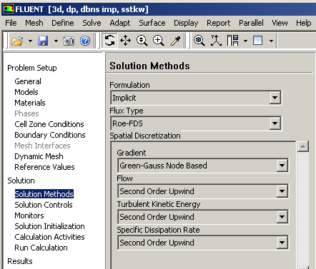
Solution Methods
Change the gradient method to Green-Gauss Node Based
This is slightly more computationally expensive than the other methods but is more accurate
Select Second Order Upwind for flow and turbulence discretization
To accurately predict drag, select the ‘Second Order Upwind’ schemes.

Slide 20
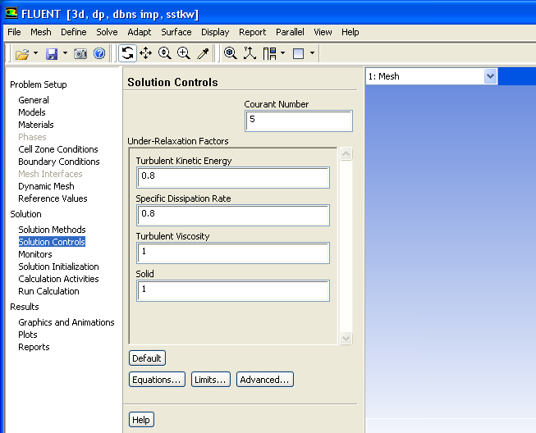
Solution Controls
The Courant number (CFL) determines the internal time step and affects the solution speed and stability
The default CFL for the density-based implicit formulation is 5.0. It is often possible to increase the CFL to 10, 20, 100, or even higher, depending on the complexity of your problem. You may find that a lower CFL is required during startup (when changes in the solution are highly nonlinear), but it can be increased as the solution progresses
As we will be using automatic ‘solution steering’, the choice of CFL at this stage is not important for this case
Keep the default under-relaxation factors (URFs) for the uncoupled parameters

Slide 21
Solution Monitors - Residuals
Set up residual monitors so the convergence can be monitored
Monitors > Residuals > Edit
Make sure ‘plot’ is on
Turn off convergence checks by setting the criterion to ‘none’
This means that the calculation will not stop based on the residual plots convergence, but you can still see their progress.

Slide 22
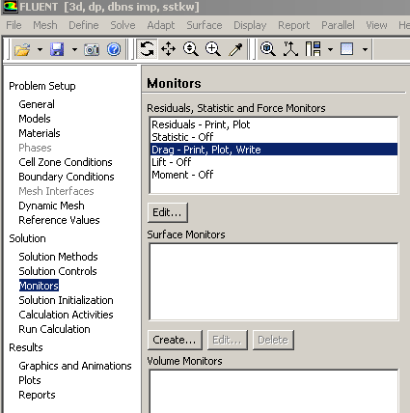
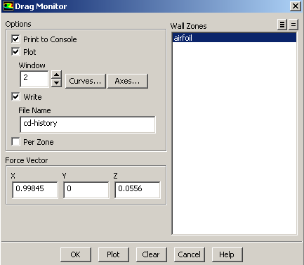
Solution Monitors – Drag & Lift
Set up a monitor for the drag coefficient on the airfoil.
Select both wall zones and toggle on ‘Print’, ‘Plot’ and ‘Write’.
Remember that α is 3.19° so we need to use the force vector as shown
Lift and drag are defined relative to the wind, not the airfoil
Press OK, then follow the same process to setup a monitor for Lift
The settings are identical except for the File Name (cl-history instead of cd-history) and the Force Vectors: -0.0556 as x component and 0.99845 as z component

Slide 23
Solution Initialization
Initialize the flow field based on the far-field boundary
Select Solution Initialization from the model tree
Compute from > inlet
Press ‘Initialize’

Slide 24
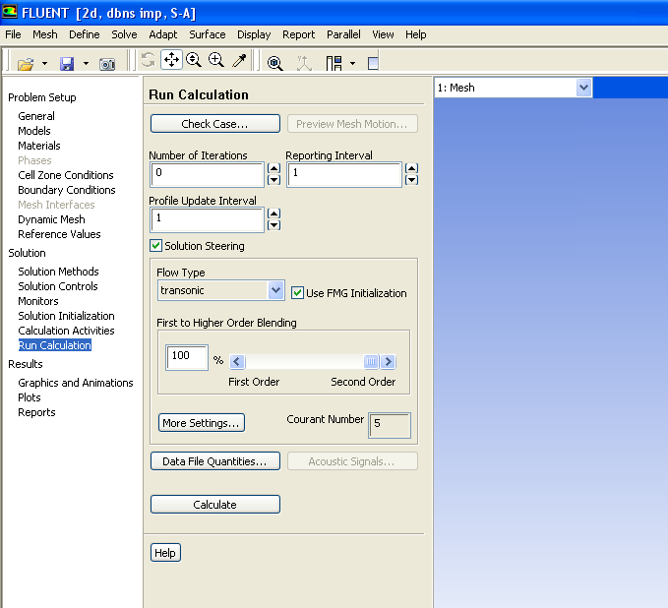
Solution Steering
Enable the Solution Steering option
Select Run Calculation, and toggle on Solution Steering
Change the flow type to transonic
and keep default options
Click on Use FMG Initialization
Full-Multi-Grid Initialization will compute a quick, simplified solution based on a number of coarse sub-grids. This will then be used as a starting point for the main calculation.
FMG initialization can help to get a stable starting point
Solution Steering enables the robust first order discretization in the early-stages of the computation, then blends to the more accurate second order schemes as the solution stabilizes

Slide 25
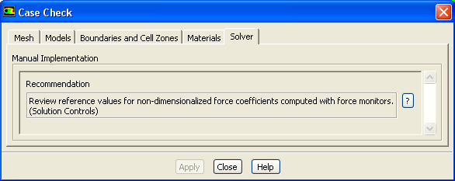
Case Check
Check the case file and make sure there are no reported issues
Use Run Calculation > Check Case
Any potential problems with the case setup will be raised in the case check panel if there are no problems this panel will not appear. In this case there is a recommendation to check the reference values for the force monitors. Since we have already set these we can ignore this warning.

Slide 26
Save the Case File
Save the case file
File > Write Case
You can write case and data files with extension .gz – the files will be compressed automatically

Slide 27
Run Calculation – FMG Initialization (1)
Although the calculation is ready to compute, It is good practice (but not strictly necessary) to run the FMG initialization and then check the coarse FMG solution before starting the main calculation iterations
Set the number of requested iterations to zero, and press ‘Calculate’
or input /solve/init/fmg at TUI
Do it twice!

Slide 28
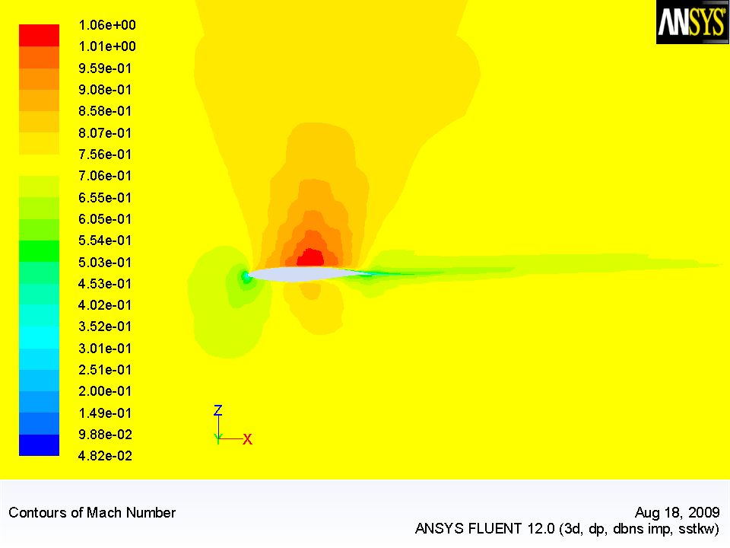
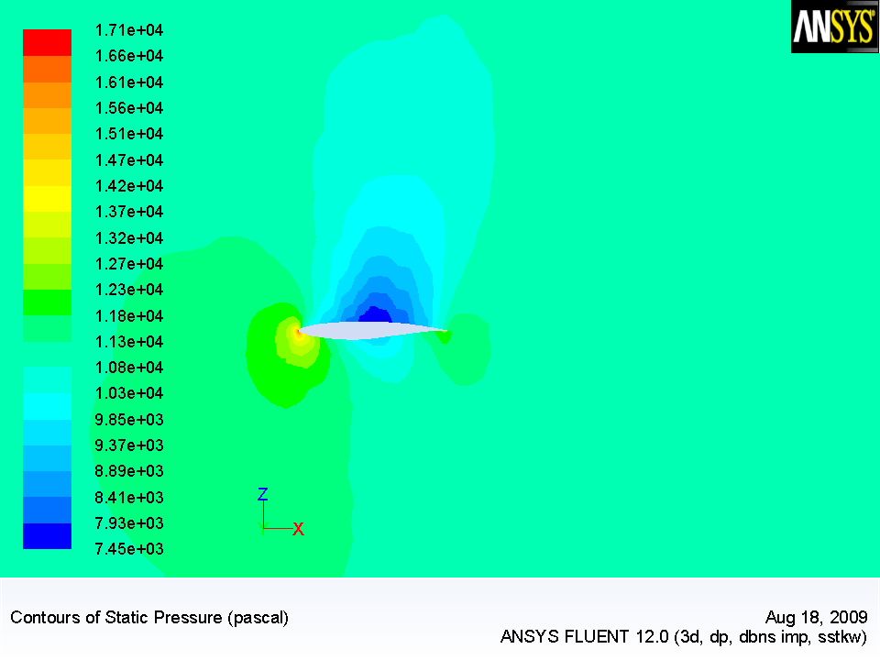
Run Calculation – FMG Initialization (2)
Check the pressure and velocity contours
Go to ‘Graphics and Animations’ in the LHS tree, choose ‘Contours’ and ‘Set Up’
Choose Contours of Pressure > Static Pressure, ‘Filled’ Option and select the Surface ‘symmetry’
Display (If you need to autoscale the display, press <control> A)
Repeat for Contours of Velocity> Mach Number
Ma
P

Slide 29
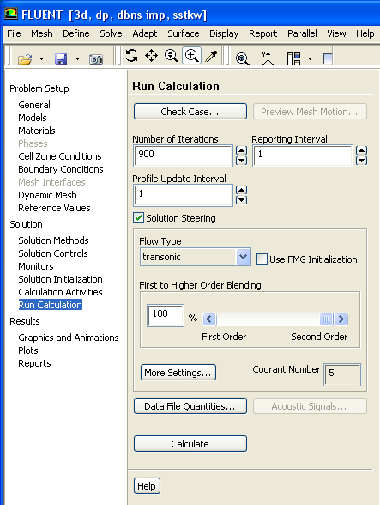
Run Calculation (1)
There are no spurious results from the FMG Initialization, so proceed to the main calculation
Return to ‘Run Calculation’ in the LHS tree
Disable ‘Use FMG Initialization’
Change the number of windows to three
for the residual, drag and lift monitors that we set up earlier (see disposition on next slide)
Request 900 iterations
‘Calculate’

Slide 30
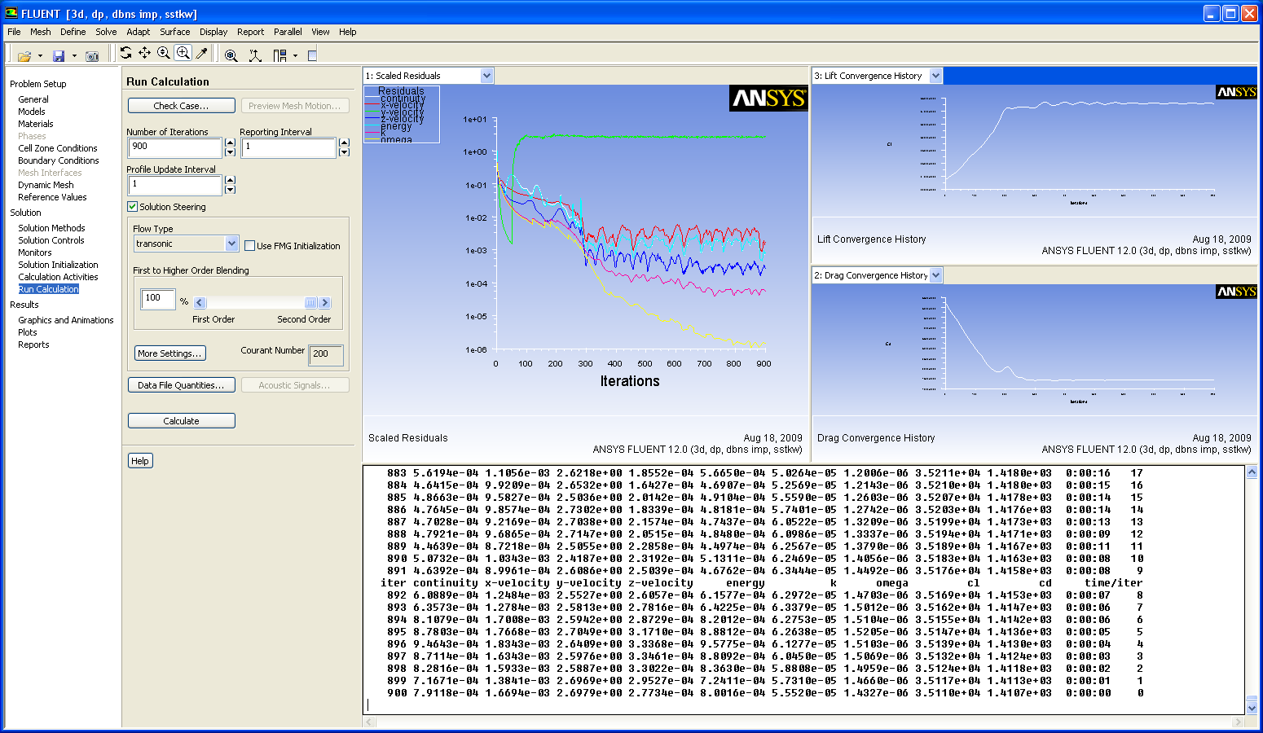
Run Calculation (2)
After 900 iterations the calculation has fully converged
Note that the CFL has been updated during the calculation in a number of stages, ramping up from 5 to 200 (as requested by default). This can be seen in the CFL window and the effect on the residuals is also evident
By the end of the calculation the residuals have converged well and are no longer changing. The drag and lift monitors are also stable
It can be observed that the Residuals of Y-velocity is quite high. This is not a problem because this simulation is a 2d analysis on the XZ plane, on Y-direction there is only one layer of cells and the flow field in that direction is not of interest !

Slide 31
Save the Case&Data Files
Save the Case&Data files
File > Write Case&Data..
You can write case and data files with extension .gz – the files will be compressed automatically

Slide 32
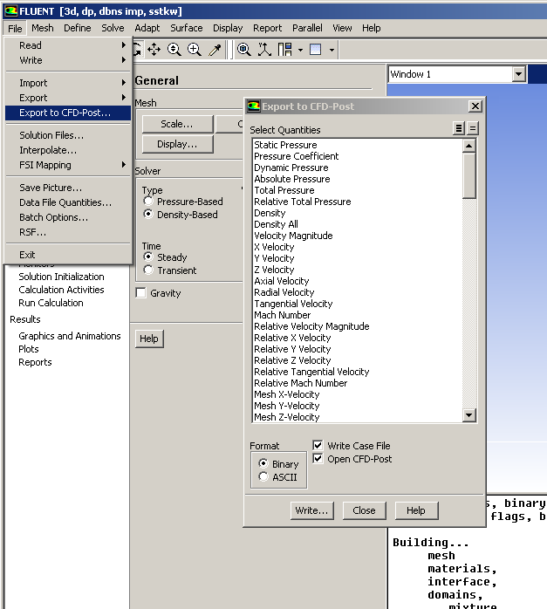
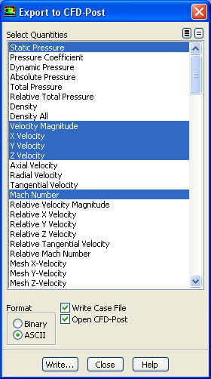
Post Processing – Data Export
Additional post-processing will now be performed in CFD Post
Export the data in CFD-Post compatible Format
You can specify which values you will have for Post-processing
Velocity Magnitude and Components
Mach Number
Pressure
Click on ‘Open CFD-Post’ to automatically start a CFD-Post session
Close FLUENT (File > Exit)

Slide 33
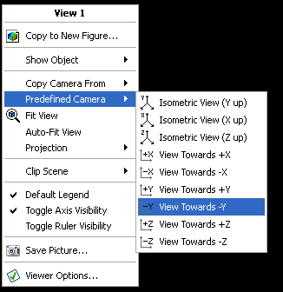
CFD-Post
Define the Post-processing view
Right-click on a blank area of the screen and select Predefined Camera>View Towards –Y
Use the box zoom so the viewer displays the region around the airfoil

Slide 34
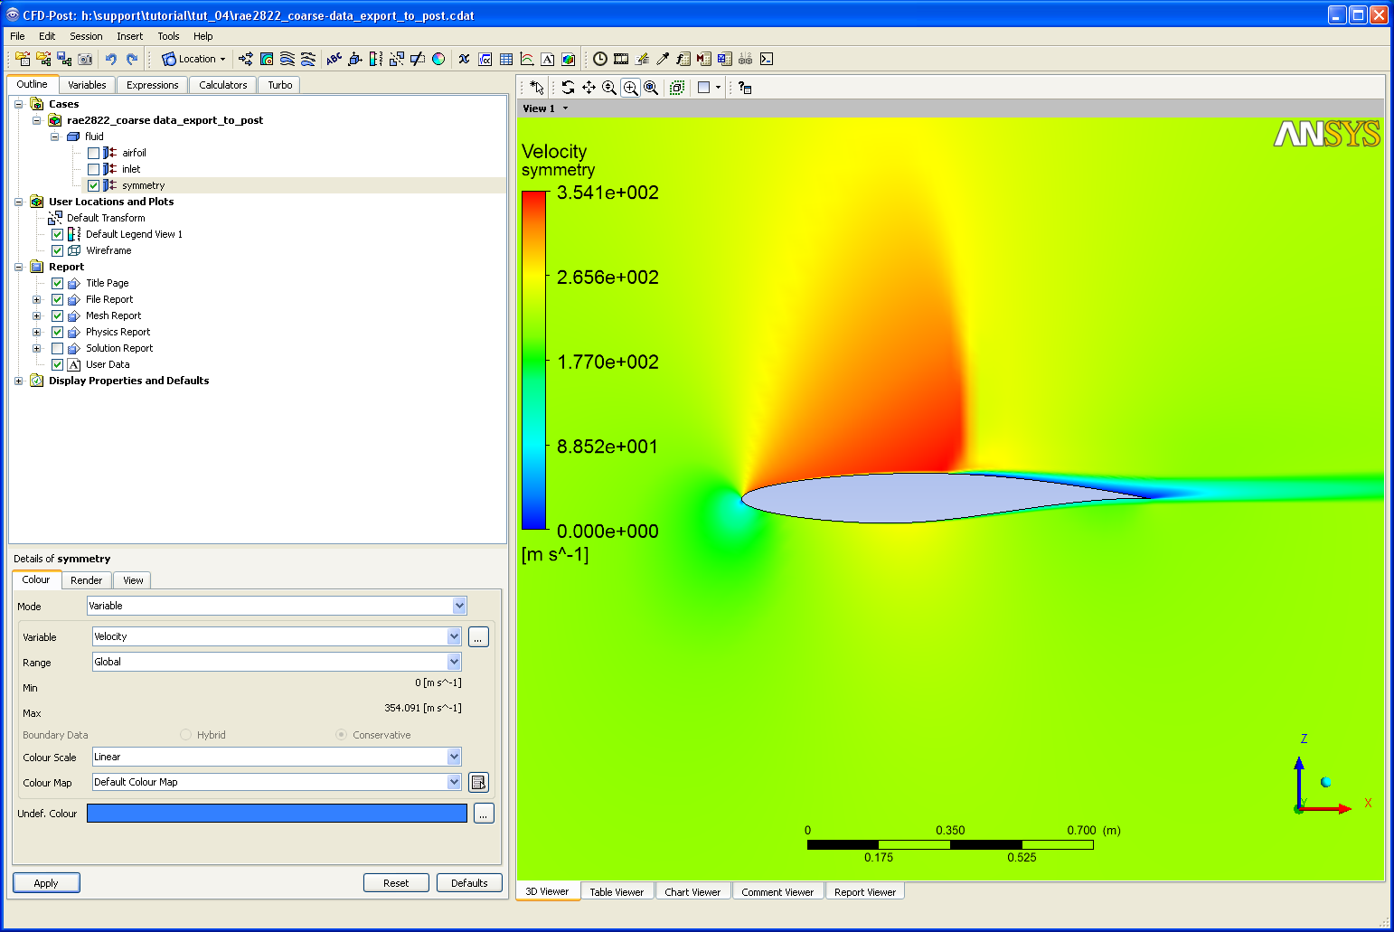
CDF-Post
When looking at the flow around an airfoil, plots of several variables can be of interest such as velocity, pressure, and Mach number
In the tree turn on the visibility of symmetry by clicking in the tick box the double click on it to bring up the details section
Under the Colour tab change the mode to Variable and select Velocity using the Global Range, then click Apply.
Notice that the maximum velocity is around 354 m/s

Slide 35
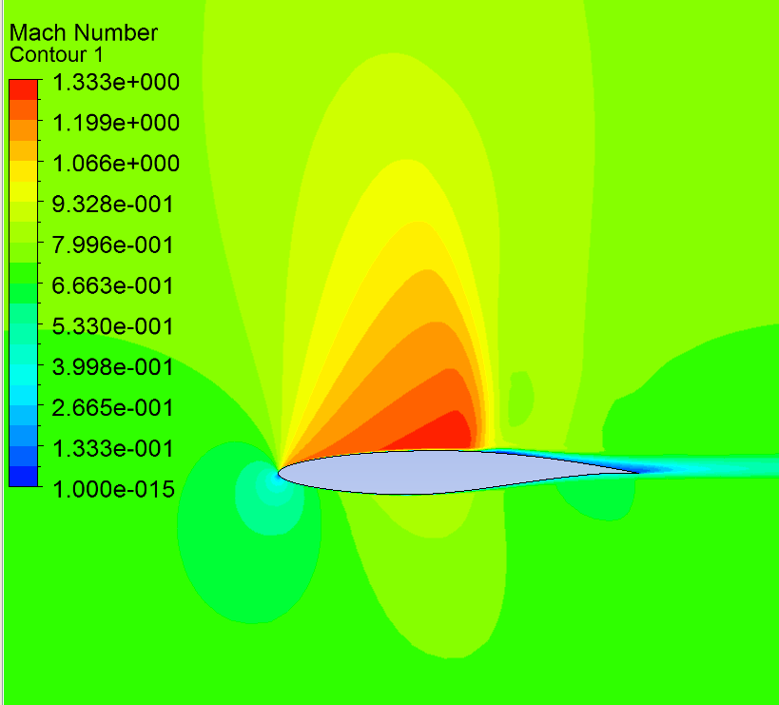
CFD-Post
To plot Mach number a contour plot will be used so the supersonic region can clearly be identified
Select Insert>Contour or click on the contour icon
Accept the default name then set Location to symmetry and the Variable to Mach Number
Change the Range to User Specified and enter 0 to 1.33 as the range
Set # of Contours to 21, the click Apply

Slide 36
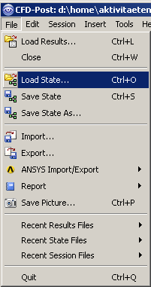
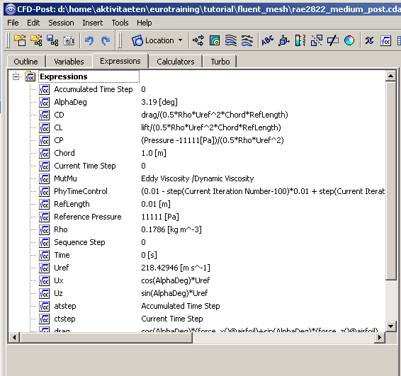
CFD-Post
To have some further variables available (Pressure Coefficient, Lift Coefficient, …) we need some Expressions
Read these with File > Load State expressions.cst
Now you can see the Definitions in the Expression Tab

Slide 37
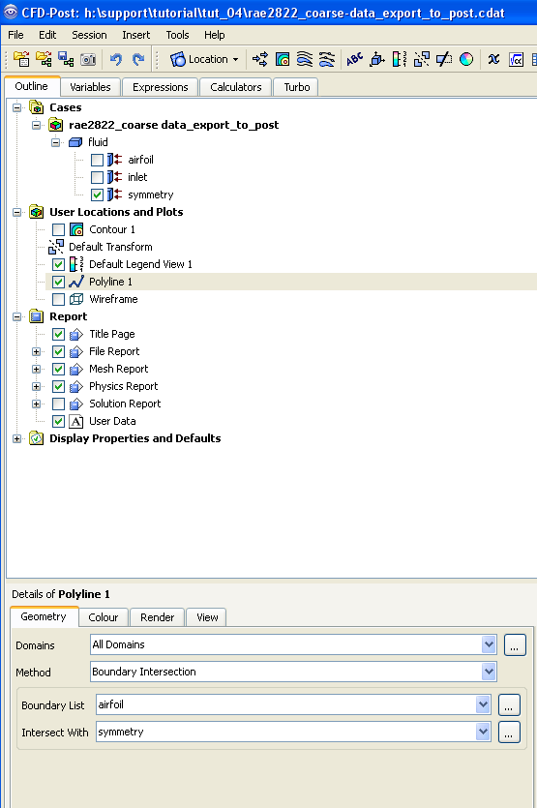
CFD-Post
To plot the pressure coefficient distribution around the airfoil a polyline is needed to represent the airfoil profile and a variable needs to be created to give CP
Create a Polyline using Insert>Location>Polyline
Change the Method to Boundary Intersection
Set Boundary List to Airfoil, Intersect With to Sym 1 then click Apply
A line will be created around one end of the airfoil
For full 3D cases other locations could have been extracted if a XY plane was first created

Slide 38
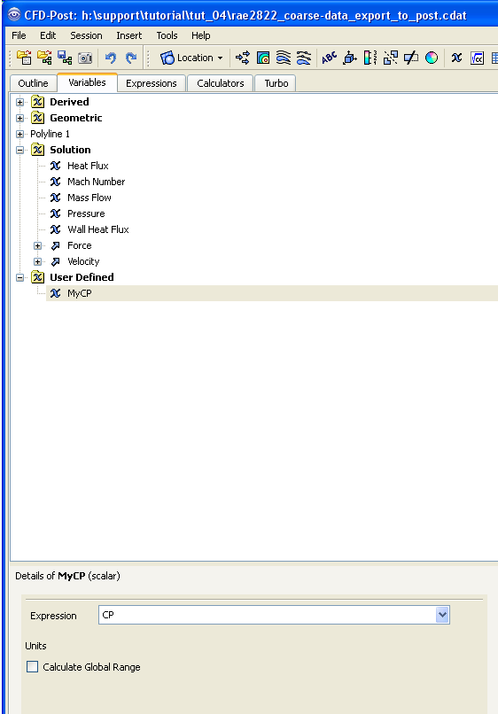
CFD-Post
4. Move to the Variables tab and enter a variable MyCP
- Set the Method to Expression and select CP

Slide 39
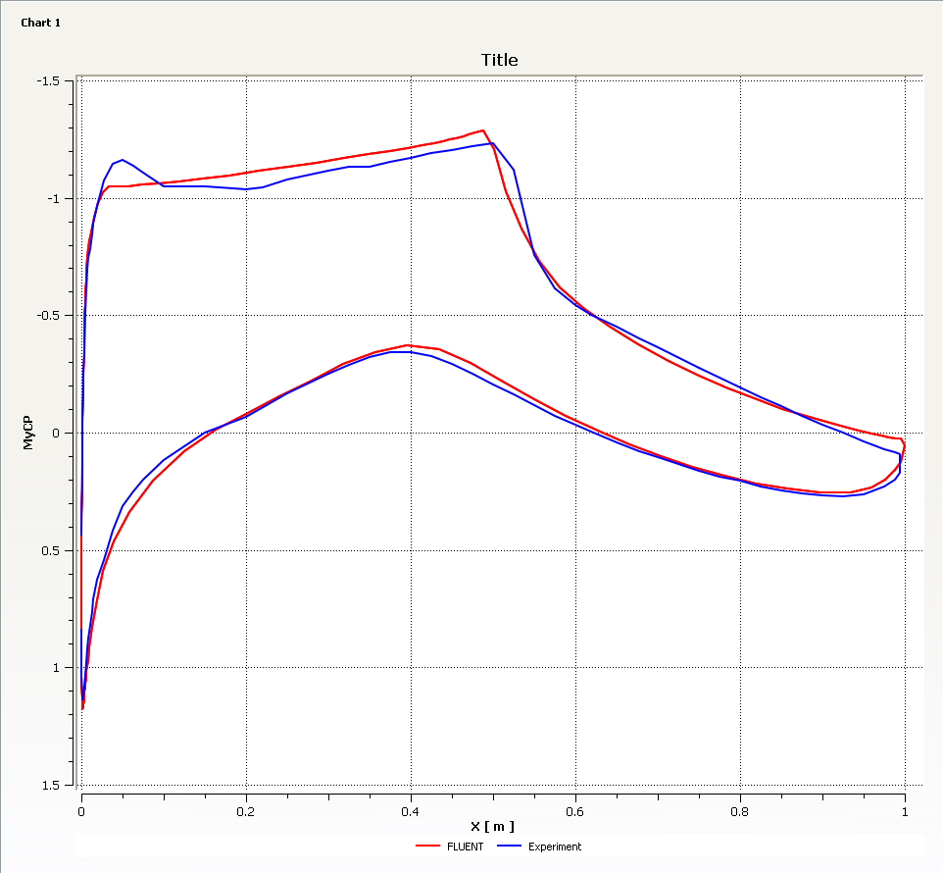
CFD-Post
A chart showing the pressure distribution around the airfoil will now be created
Insert a chart using Insert>Chart or selecting .
In the General tab leave the type as XY
Move to the Data Series tab and enter a new series
- Set the location to Polyline 1
Move to the X Axis tab and change the variable to X
Move to the Y Axis tab and change the variable to MyCp
- Invert Axis selected
Click Apply and the chart is generated
These values can be compared with experimental results
Return to the Data Series tab and change the name to FLUENT
Insert a new series and give it the name Experiment
Change the Data Source to File and select ExperimentalData.csv
Click Apply and both lines are drawn

Slide 40
Summary
In this tutorial we have used FLUENT to compute the transonic, compressible flow over a RAE 2822 airfoil
We have used the density based solver with solution steering
We have seen how FLUENT can be linked to CFD Post, and we have explored some of the features within CFD Post
We have compared the results to published experimental data
Next step could be to use medium and fine mesh – Grid dependency of solution?

Slide 41
References
AGARD 138; Test Case 13A
Airfoil RAE 2822 – Pressure distributions and boundary layer and wake measurements; Cook, McDonald, Firmin

Slide 42
Appendix: Post-Processing FLUENT

Slide 43
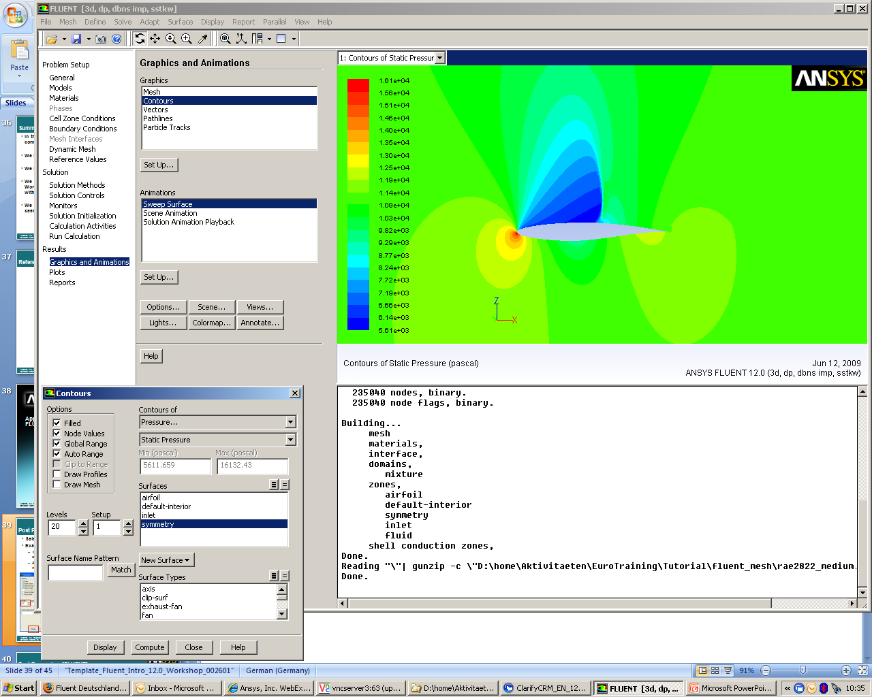
Post Processing [FLUENT]
Select ‘Graphics and Animations’ in the LHS menu
Examine the contours of static pressure.
Turn off ‘Filled’ to just display the contour lines
Adjust the Levels to increase the number of contour lines
The contour will display in the active window (click a window to activate). Alternatively, use the drop down menu to return the display to a single window as shown here

Slide 44
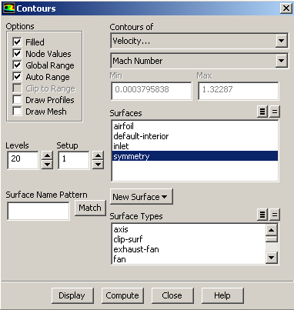
Post Processing [FLUENT]
Plot contours of Velocity > Mach Number and notice that the flow is now locally supersonic

Slide 45
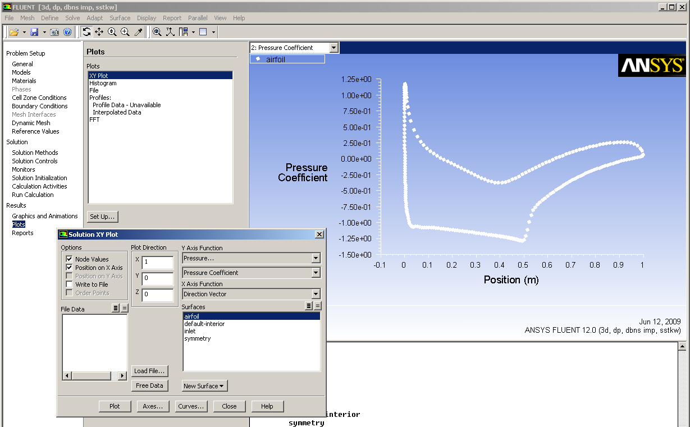
Post Processing [FLUENT]
Select ‘Plots’ in the LHS menu
Plot Pressure Coefficient along the airfoil surface

Slide 46
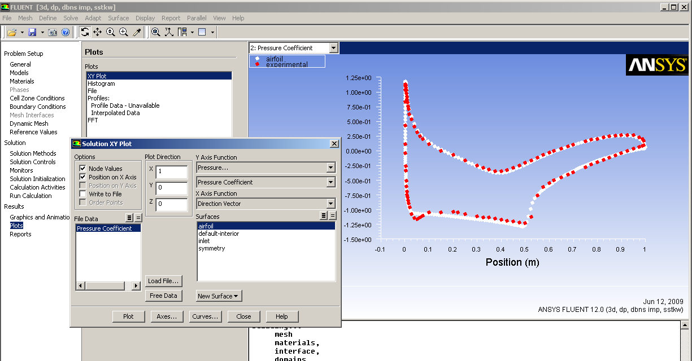
Post Processing [FLUENT]
Once loaded, plot the CFD and experimental Cp (experiment.xy) plots together
A good agreement can be seen

Slide 47
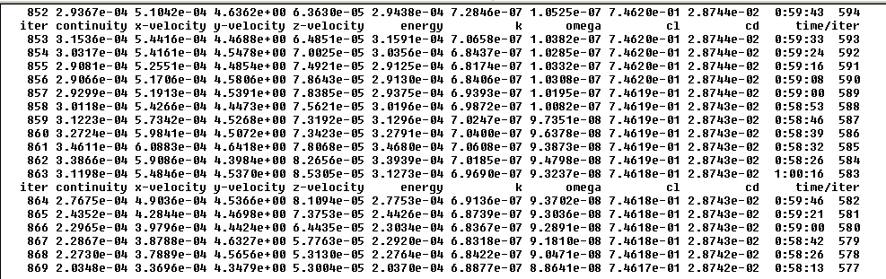
Post Processing [FLUENT]
Compare the predicted C_{L} and C_{D} against the experimental values.
From Reference
C_{L} = 0.733 and C_{D} = 0.018
From the console window, we have predicted
C_{L} = 0.746 and C_{D} = 0.0287
Reason for Difference?
Wall interference > effective angel of attack 2.82°

